Slide 1
Premier league 2019-2020 Analysis

Slide 2

Why Premier League 2019 2020?
Liverpool has been the most recent team and the only one a part from man city to win the league in the past seven years, and they secured this title after a 30-year wait. As a result, we may find surprising data regarding this season.

Slide 3
Project overview
This project aim to analyze the performance of teams in the English Premier League during the 2019-2020 season and examine the betting statistics.
Data set :football-data.co.uk
PROJECT OBJECTIVES: We will go through uncover insights regarding team performance, betting trends, and unexpected outcomes.
FINAL OBJECTIVE : THE FINAL OBJECTIVE WILL BE TO SEE RELATIONS BETWEEN PERFORMANCE AND BETTING Market Impact.

Slide 4
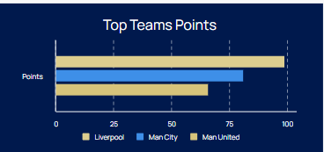
Performance
During the 2019-2020 Premier League season, the top 3 teams Liverpool, Manchester City and Man United showcased remarkable performances, though their campaigns had different narratives.
The total of 99-points total for Liverpool was an unexpected statistic before the season began

Slide 5



Betting Odds
Pre-Season Odds: Before the season began, Manchester City were favorites to win the Premier League, with odds around 4/6. Liverpool were considered strong contenders, with odds around 5/2. Despite the low odds, they revealed an unexpected winner.

Slide 6
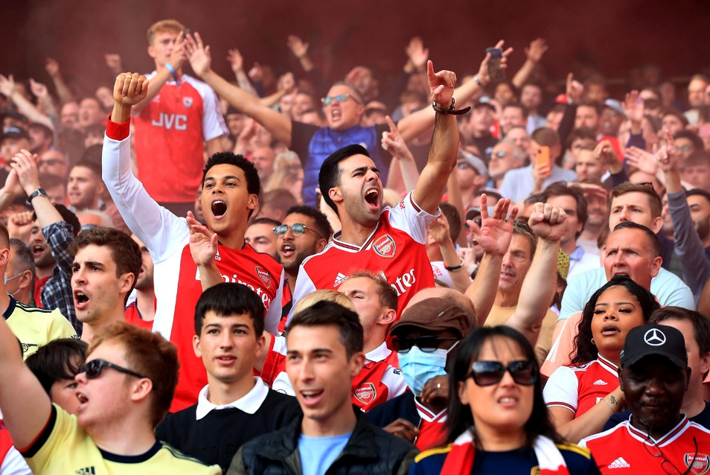
Long Shot
The term “Long shot” refers to a team, player, or outcome that is considered unlikely to occur.. Terms like "minor upset," "underdog," and "Cinderella story" describe various betting scenarios.

Slide 7
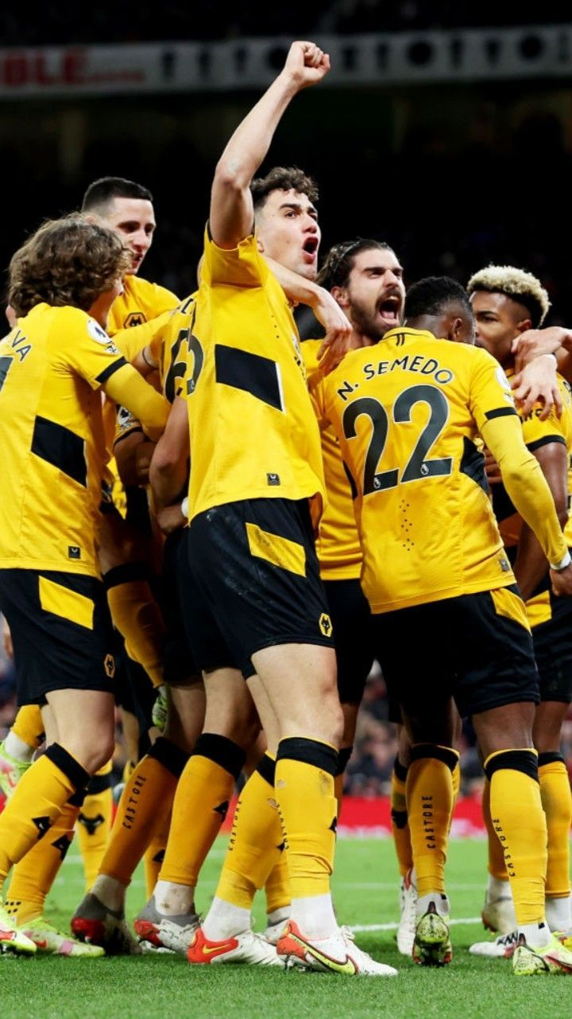
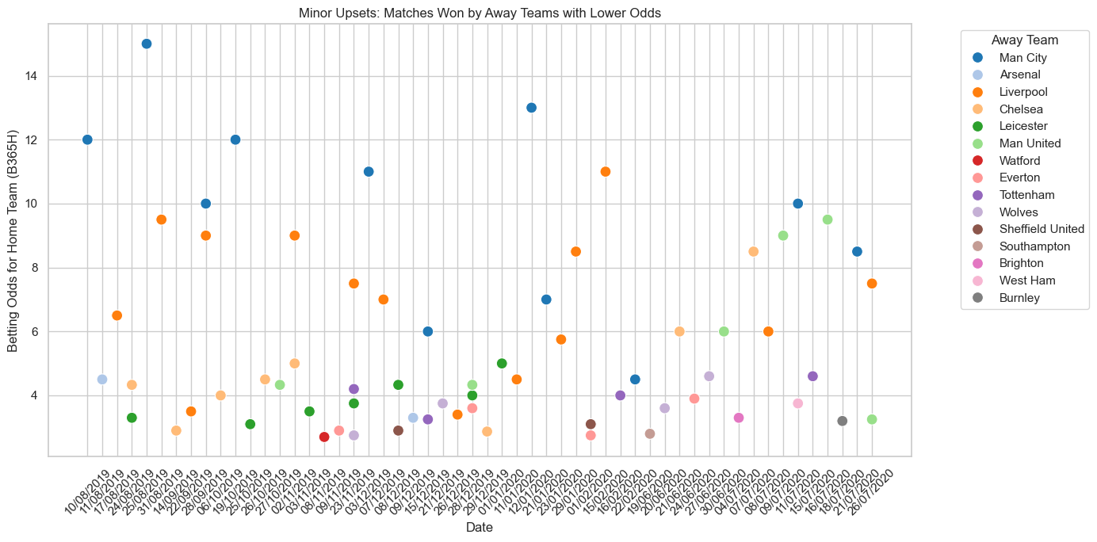
Minor Upset Team
One of the minor upsets in the Premier League season 2019-2020 was Wolverhampton who continued to establish themselves as a strong team in the league their odds for finishing in the top half of the table were around 10/1 or 12/1. Team ended the season 7th position.

Slide 8
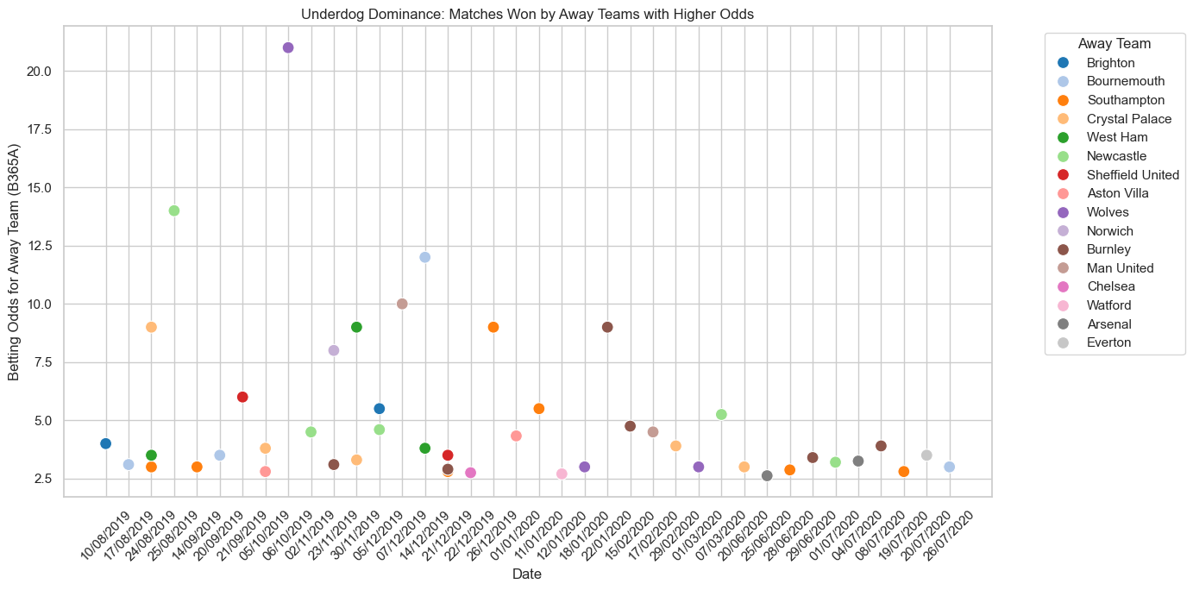
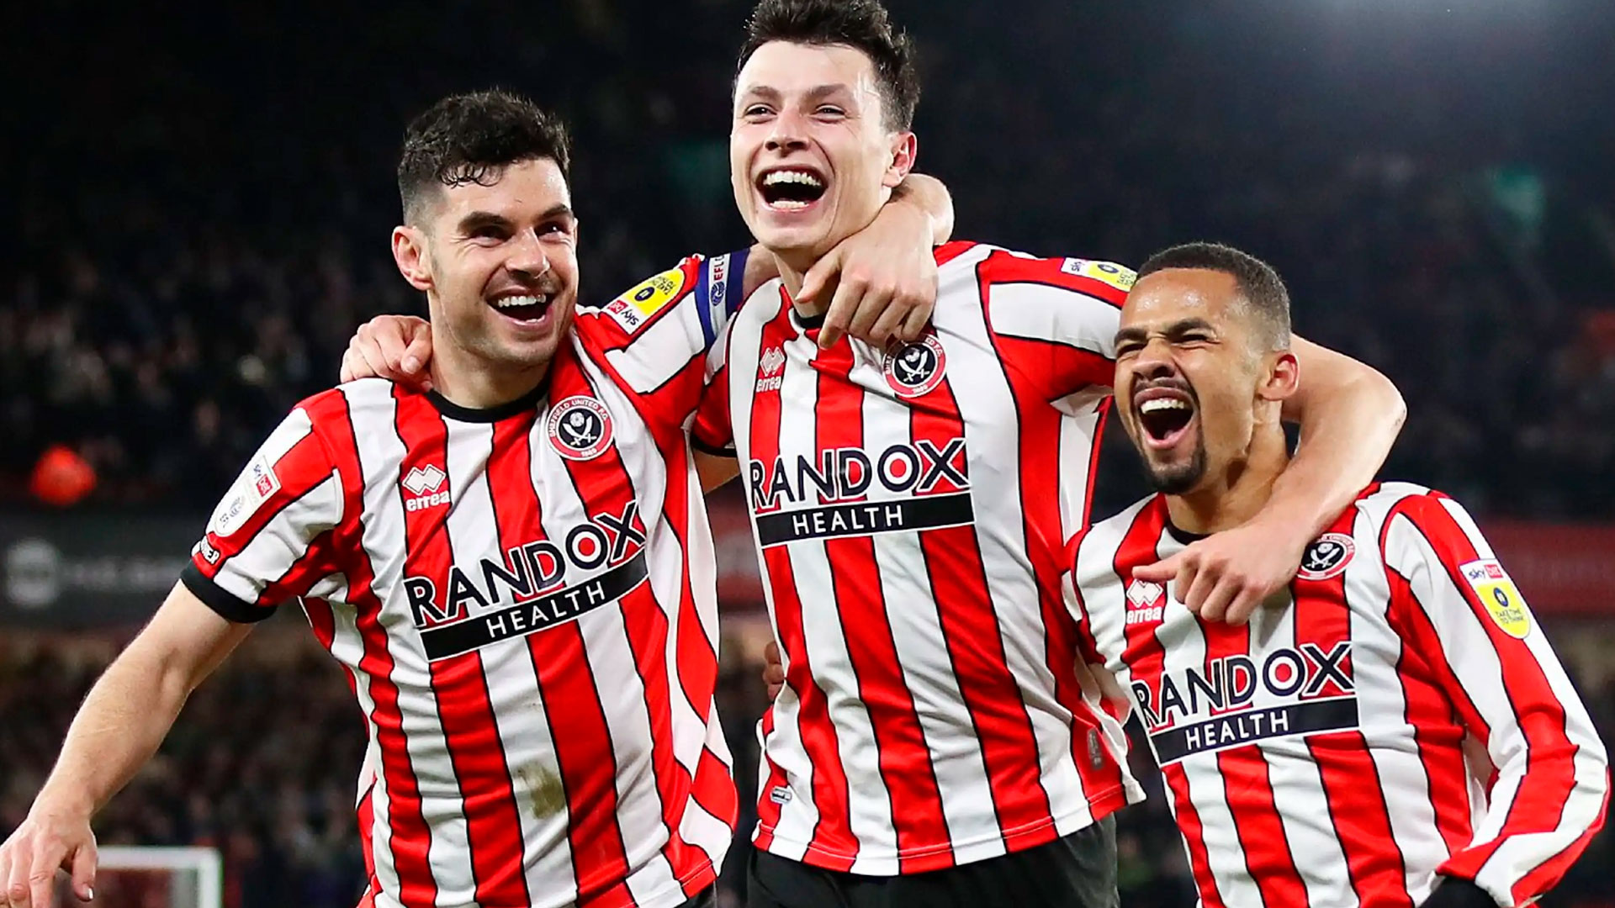
Underdog Team
One of the underdog teams in the Premier League in the 2019/2020 season was Sheffield United. They were quoted at around 50/1 or 100/1 for them finishing in the top half. Team end the season in 9th position.

Slide 9
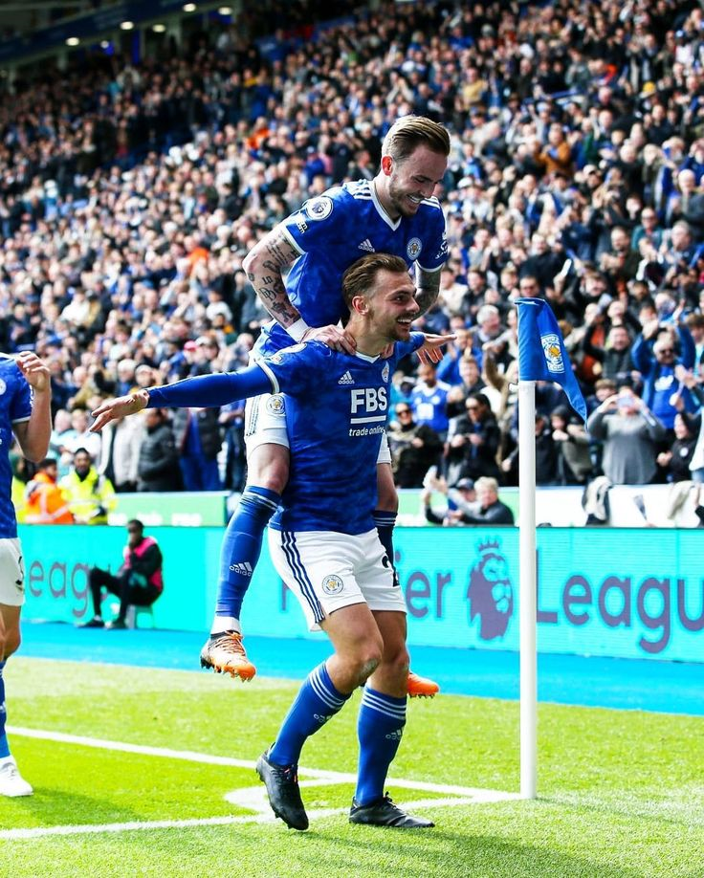
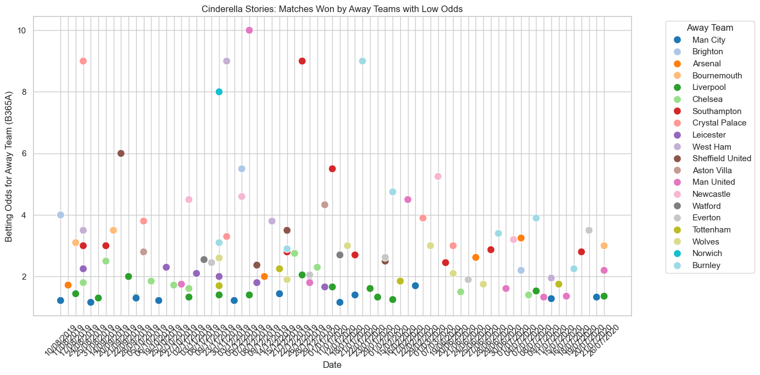
Cinderella Team
Leicester City made impressive performance and exceed the expectation and had them competing for a top four spot. Leicester City was quoted at odds of around 15/1 to finish in 5th place.

Slide 10

Conclusion
THE IMPORTANCE OF DATA ANALYTICS
The impact of relationships on sports betting could greatly benefit from the utilization of advanced analytics. These tools can help us better understand betting behavior and market trends, leading to more accurate predictions and smarter decisions.

